Slide 1

Public Speaking
or
How to use all your tools to sell your ideas.

Slide 2
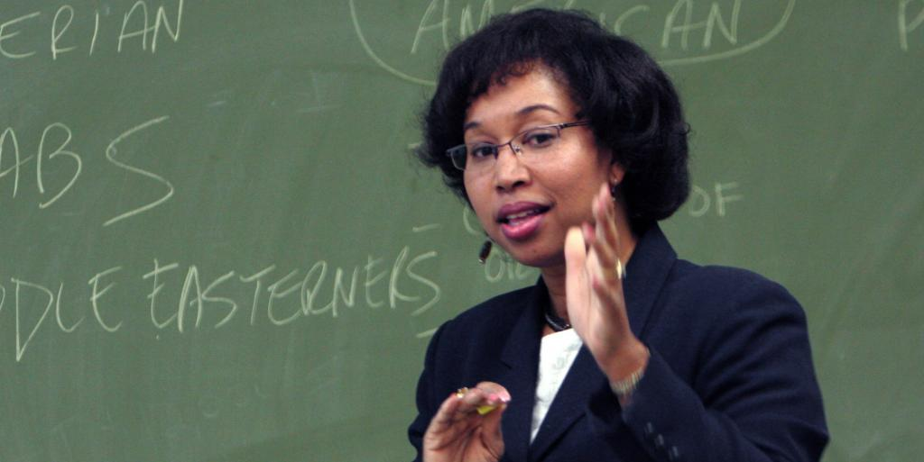

College is all about communicating.
Sometimes it’s what people tell you.
Sometimes it’s what you tell them.

Slide 3
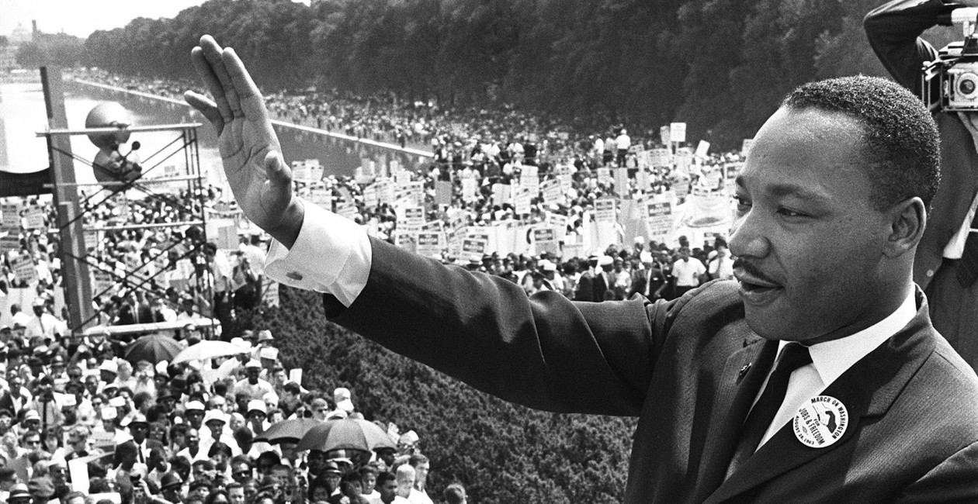
None of us are born knowing how to make presentations.
And few of us are naturally comfortable standing in front of a class, much less a big crowd!

Slide 4

But believe it or not – public speaking is a skill you can learn.
Yes, you.

Slide 5

Remember:
Nobody knows how you feel.

Slide 6

People will only see what you show them.

Slide 7

To make it easy for you, we identified nine simple points.

Slide 8

You don’t have to learn them all at once.
And you probably do some things on this list already. And some of these points are pretty easy.
So relax! Don’t let presentations “bug” you!

Slide 9
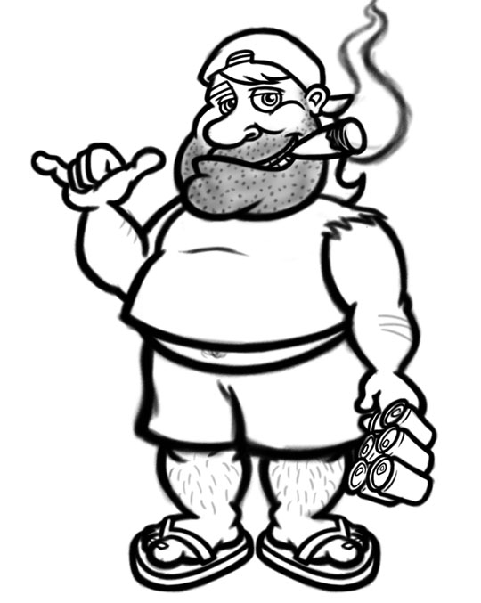
Item 1. Appearance.
How you look affects how people react to what you say!

Slide 10

This doesn’t mean that you have to “dress formal.”
But it does mean that you have to think about your audience.
Is your appearance appropriate for them?

Slide 11
For example, you would not make a presentation to a professional organization wearing shorts and a tee shirt.
But if you were making a recruiting pitch at a local high school, would you wear a suit? Perhaps not.

Slide 12

And you wouldn’t likely go to meet your future in-laws in the same outfit you wore on your first date!

Slide 13
So your appearance should fit the audience and the subject matter!
Do this, and your audience will see you as appropriately prepared.

Slide 14

Item 2: Body language.
Your body is talking even when you are not!

Slide 15
To manage this non-verbal communication...
Stand up straight (but don’t be stiff!).
Keep an appropriate facial expression.
Be conversational and use gestures to emphasize your main points.

Slide 16
Students ask: What do I do with my hands?
Relax. Gesture naturally as you would with your friends or family.
You might hold a note card or whiteboard marker. This helps your hands to “relax.”
Keeping your hands occupied is a nice trick to help the rest of you to relax, too.

Slide 17

But the most important trick to be relaxed – is to be prepared!
Preparation instills confidence!

Slide 18

If you’ve done the work, you have nothing to worry about.

Slide 19
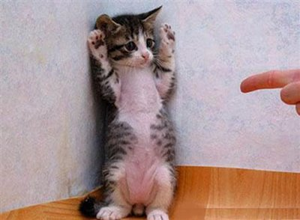
Item 3 – Engage your audience.
Remember, we’re not taking hostages. Your audience will enjoy your presentation more if they help!

Slide 20

So you ask, “How can my audience help?”
Ask questions! Get them thinking. Draw them into participating, too!

Slide 21


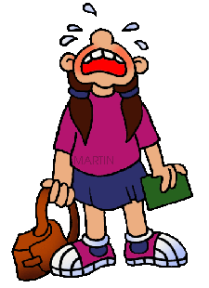
Item 4 – Control your emotions.

Slide 22
To control your emotions doesn’t mean that you don’t feel emotions.
It means that you keep them in perspective.
You’re standing in front of an audience, not walking through a minefield.

Slide 23

Nobody’s perfect.
It’s okay to make a mistake.
In fact, if you do, the odds are pretty good that nobody but you will notice!

Slide 24
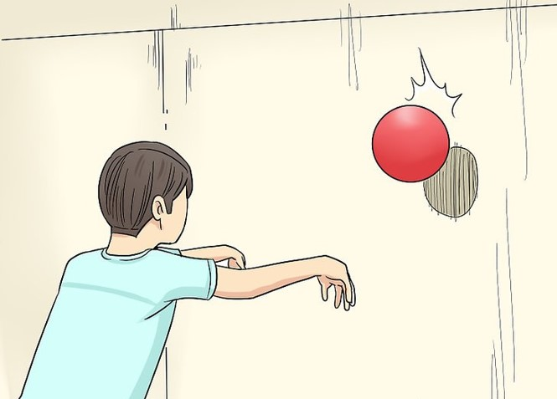
So use your passion. What you say may make your audience think.
How you say it will move them to action!
It’s like bouncing a ball against a wall – the energy that comes back to you depends on the energy you put into the throw.

Slide 25
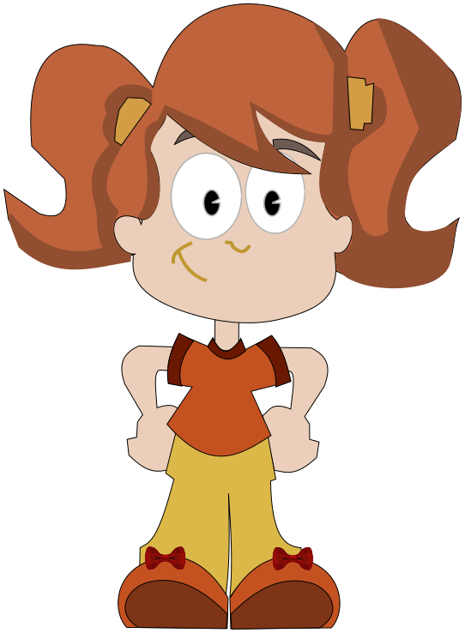

And to control your emotions is to present yourself as confident.

Slide 26

Item 5 – Make eye contact.

Slide 27
Your audience is there to listen to YOU.
YOU are in control.
Look at your audience.
If you need to pick out one or two friends to make eye contact with, that’s okay.

Slide 28
Look around. “Listen” with your eyes. Make sure your audience is listening and understanding.
If not, you might have to take an extra moment to explain something.
Or perhaps they need a change-of-pace.
Raise your voice. Lower your voice. Vary the pace of your talk.

Slide 29

Remember, if you’re not paying attention to them, they’re probably not paying attention to you, either!

Slide 30

Item 6 – Use all of your voice.
Think of your message as music.

Slide 31
You’ll want to vary your volume, your modulation, and your speaking speed.
There are even times when it’s appropriate to stop altogether.
A good pause can speak volumes. It also allows your audience to digest what you just said.

Slide 32
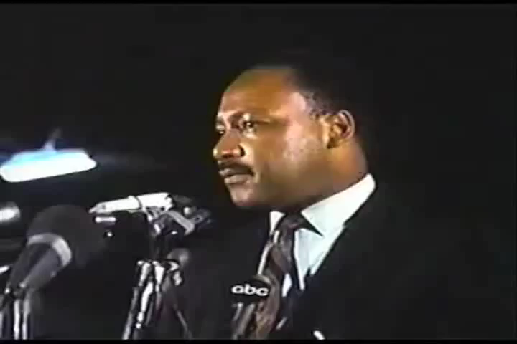
Listen to this speaker and see how he uses his voice to evoke a response from the crowd.

Slide 33
You don’t have to speak like Martin Luther King to make a good grade in this class.
But speaking persuasively will help you in many ways throughout your life.
Job interviews? Performance reviews? Consumer complaints? A court appearance? Buying a house? A hot date?

Slide 34
Item 7 – Emphasize the right words.
To emphasize is to draw attention to your main ideas – not some random word or sentence.
So when you use your voice to emphasize, make sure that you are emphasizing an important word or phrase.

Slide 35
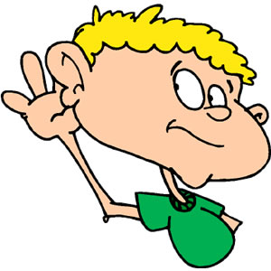
Item 8 – Speak clearly!
Everyone speaks with an accent.
English language learners have to pay special attention to this.

Slide 36

No matter how great your ideas are, your message is lost if you cannot communicate it clearly!

Slide 37
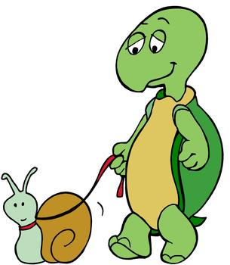
So remember to slow down and pronounce your consonants clearly.
A little bit of an accent, like a little bit of pepper, is great. But too much spoils the noodles!

Slide 38

Our ninth (and final) item – Avoid staccato repeaters, filler words, slang, profanity, and stuttering.

Slide 39
Staccato repeaters are vocalized expressions like “uh-uh-uh.”
Nervous and inexperienced speakers do this all the time.

Slide 40

You can eliminate this habit with calm, focused practice. Take your time. Be sure of what you want to say before you start to say it.

Slide 41
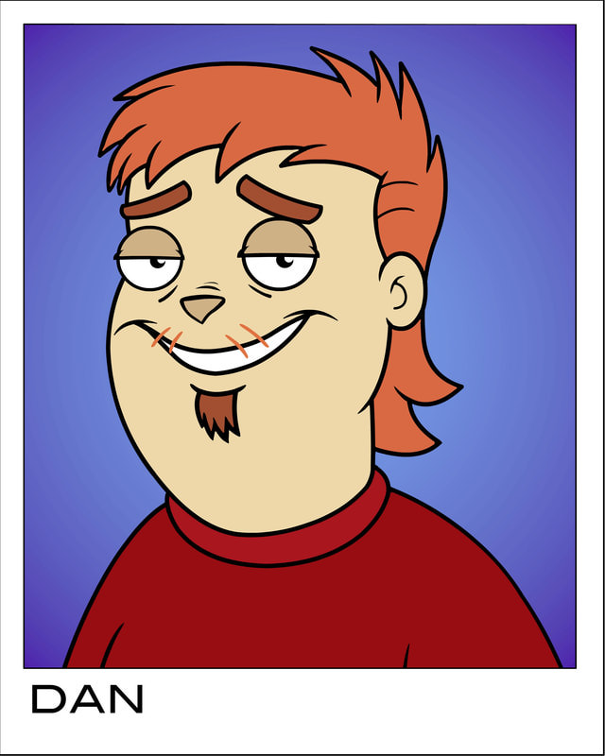
Filler words include like, you know, those annoying, like, things that, like, people like, say, you know, when, uh, they aren’t really like, uh, sure of, like what they’re, like, uh, saying. You know?

Slide 42

For example…

Slide 43
And as for slang and profanity, I won’t say never, but be very careful about this.
You don’t want to offend anyone if you can help it.
And you certainly don’t want to give any ammunition to your enemies (if you have any).

Slide 44
So that’s it. Nine simple things.
You don’t have to master them all at one time.
But choose one at a time and see if you can improve in your future presentations!

Slide 45

Thank you for your attention!

